Slide 1
Application Layer Traffic Optimization (ALTO) WG
OpenALTO Implementation, Deployment Supporting LHCONE Use Cases Presenter: Lauren Delwiche on behalf of team (Jensen, Kai, …)
IETF 115 Hackathon
06 November 2022, London

Slide 2

Context: OpenALTO, openalto.org
openalto.org
OpenALTO is an open-source implementation and platform of ALTO (MIT License).
Available at https://github.com/openalto/alto
openalto.org is a running instance of deployment of OpenALTO, providing network information, in particular, in the context of data-intensive sciences, such as LHCONE.

Slide 3
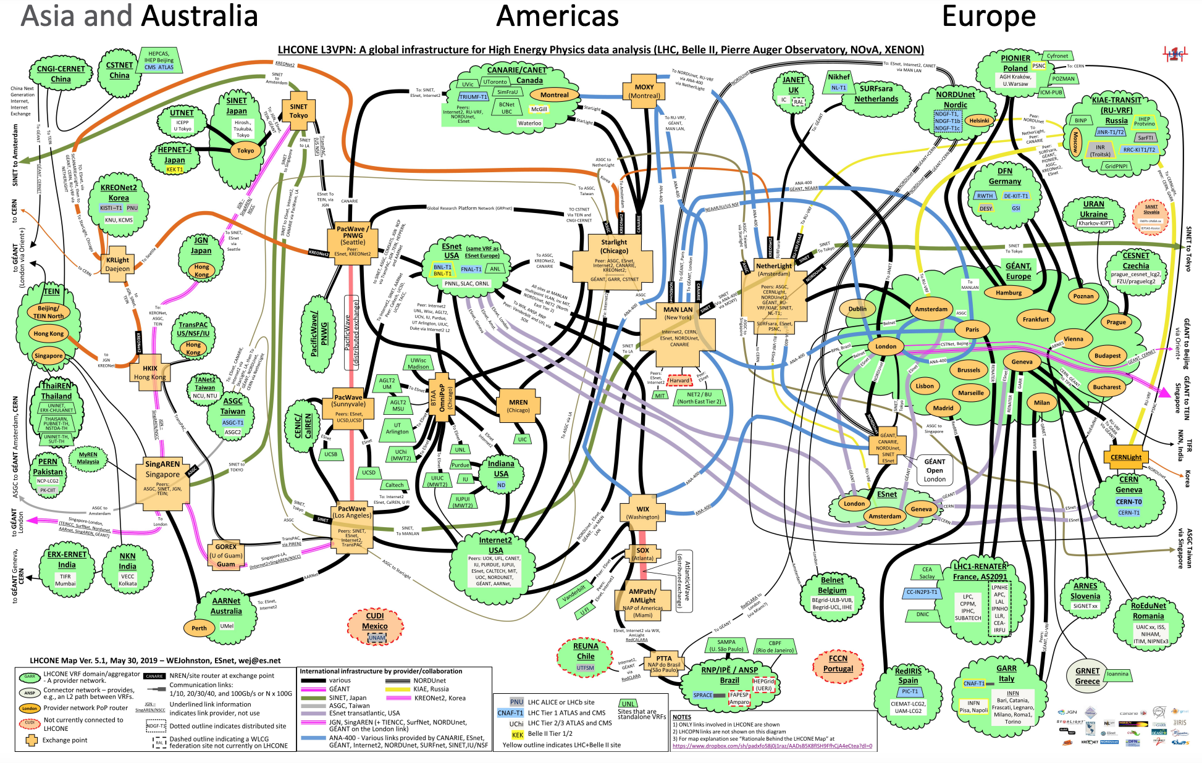
Context: LHCONE

Slide 4
Context: LHCONE, openalto.org Use Cases
ALTO+Rucio Integration: Data Flow Orchestration
ALTO/TCN+FTS Integration: Scheduling of Data Movement Tasks
openalto.org: visibility of LHCONE network routing state

Slide 5
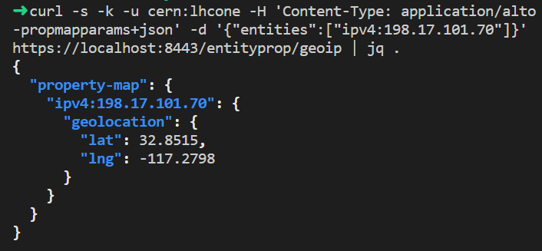
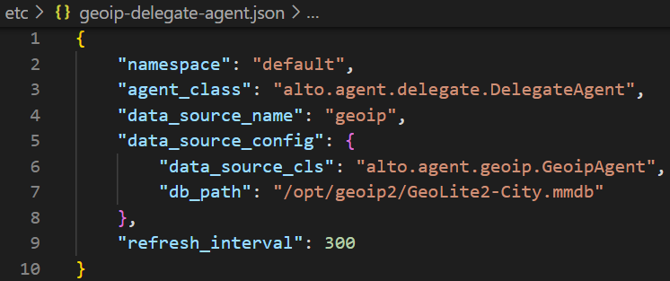
Hackathon Achievement I: GeoIP and GeoDistance
Providing geoip property using the standard ALTO endpoint property service [RFC 9240]
Providing geo distance between endpoints using the standard ALTO Endpoint Cost Service (ECS) [RFC 7285]
Query interface
Implementation Config
Notes:
Wording: Initial, not to change the default Rucio selecting data movement. GeoDistance is a default data movement selection mechanism in Rucio, and we now use alto to provide the standard implementation. Unifying the interface. Use download file; or use Web service

Slide 6
Hackathon Achievement II: Obtain Routing Paths
IETF ALTO Protocol as Front End
Control Plane
Data Plane Control: FIB
Data Plane Data: Sample
Config->FIB
FIB/DP driven
G2 snapshot
Samples (netflow, sflow)
PerfSonar (ICMP)
Equivalent Class
Looking Glass
P4
<switch interface , pkt attr>
<src, dst, <metric, val>>
adjac
subnets
BGP input
Notes:
Wording: Initial, not to change the default Rucio selecting data movement. GeoDistance is a default data movement selection mechanism in Rucio, and we now use alto to provide the standard implementation. Unifying the interface. Use download file; or use Web service

Slide 7
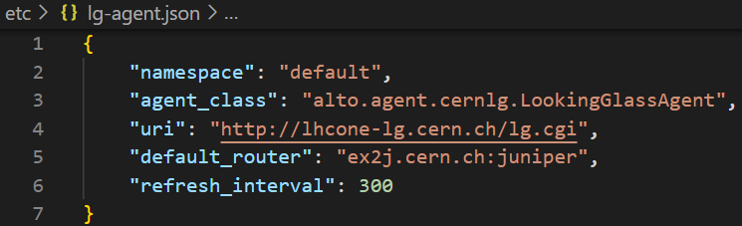
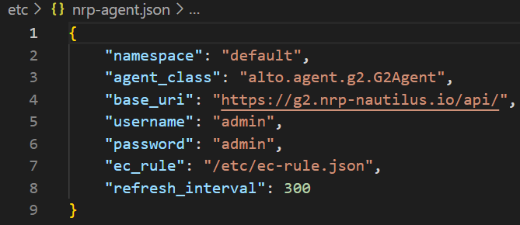
FIB/LG and DP Sampling Implementation
FIB Retrieval (LG; deployment at CERN and GEANT)
Sample + Equivalent Class (Deployment at NRP)

Slide 8
Hackathon Achievement III: openalto.org as Global Query Orchestration Platform
Good progress, not complete implementation by end of Hackathon
High-level protocol query process: openalto.org orchestrates the multi-domain query process for LHCONE:
Lookup srcIP in Internet Routing Registry (IRR) to obtain source AS
Query ALTO server of source AS to obtain AS path
openalto.org refines the AS path to obtain general path representation

Slide 9
Hackathon Achievement IV: Integration
Specify new ALTO resources to guide Rucio source selection
Specify general path to modify FTS scheduling

Slide 10
Backup

Slide 11
Using the Visibility Information: Rucio
N sources of a data item
M potential destinations of the data item
Pick K out of M destinations to replicate
Basic Rucio algorithm
Foreach s in N (sources), d in M
Compute the distance Distance_sd (current Rucio, Distance_sd == geo distance of s and d)
For the case of Distance is general path representation, we need an algebra for comparing two paths
Sort the array Distance_sd (N x M) distances
dstChose = {}
while ( |dstChose | < K )
Pick the next lowest D_sd, if the dest d has not already been chosen, dstChose += {d} // delete all Distance_sd where d appears

Slide 12
Integration w/ FTS Architecture
Src 1
Dst 1
AS 1
AS 2
AS 3
Controller (ALTO/TCN on FTS)
Resource control spec
Resource use mapping: Pipe ->Asset
Scheduler: concurrency level, time multiplexing
Trans q1
Trans q2
Trans q2
Notes:
Global traffic engineering

Slide 13
Hackathon: CERN Case (First Hop)
src
CERN
GEANT
dst
P0
Open index 0
GEANT
le1
Le1-p
src
dst
P1 (after query CERN)
le1
GEANT
le1
Le1-p
Le1-p
src
dst
P2 (after query GEANT)
le1
Le1-p

